Slide 1




GraphQL Schema Stitching
By Vilva Athiban
@vilvaathibanpb
Vilva Athiban

Slide 2
About Me
Working in SIXT R&D, as Senior JavaScript Developer.
Passionate about Browser
Have done some blogging in Medium
Recently started doing a video series for Youtube - 3 Minute React
Have done a bit of Open Source contributions as well.
I code on JS, React, GraphQL these days.
Also, I love to teach

Slide 3

Lets Start

Slide 4
What is GraphQL Schema Stitching
As per docs:
The process of merging different schemas into one GraphQL schema. These schemas can be local, remote or from third party services. In a microservice-style deployment model, where your data exists across multiple APIs, Schema stitching makes it possible to combine all of them into one schema that can be queried for all the data at once.

Slide 5
Why Schema Stitching?
One of the major advantage of using GraphQL is - Single Source of Truth.
Schema Stitching enables combines multiple GraphQL / REST data sources into single entity. Thereby enabling easy access of data from the frontend / Browser.
Let’s dig this more with an example.

Slide 6

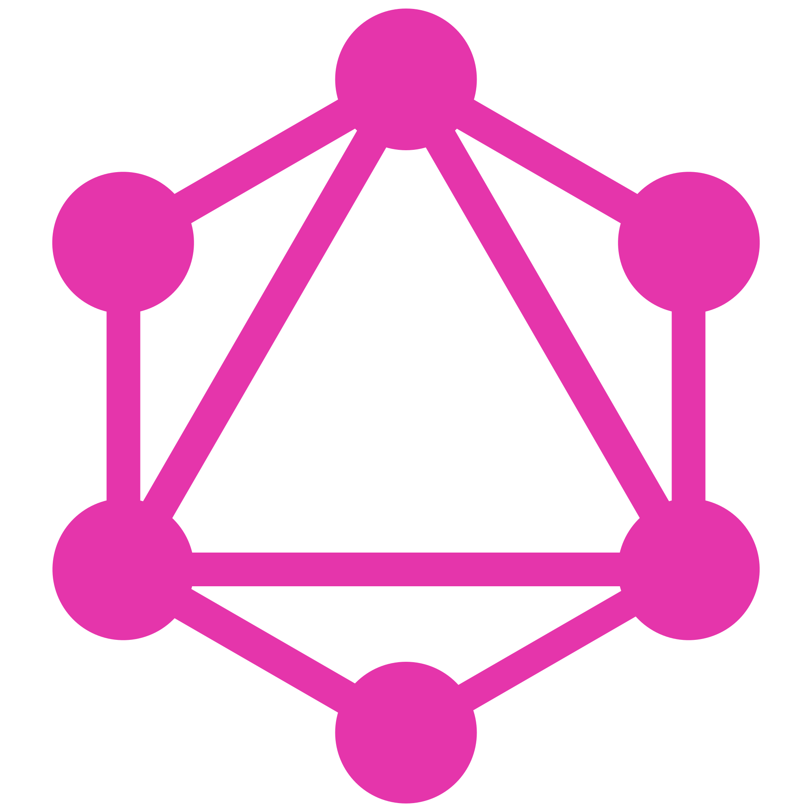


IP Address Details
Without Stitching
Loc Data Source
Country Data Source
Search History Source
Get Location data using IP
Based on location data, Country Data is been fetched.
Updates and Receives Search History
Input IP Address
Details about the IP Address’ country & Search History of IPs

Slide 7
IP Address Details
With schema Stitching
Stitched Schema
Sends Input IP Address
Gets Details about the IP Address’ country & Search History of IPs
Input IP Address
Details about the IP Address’ country & Search History of IPs

Slide 8

Now How?

Slide 9
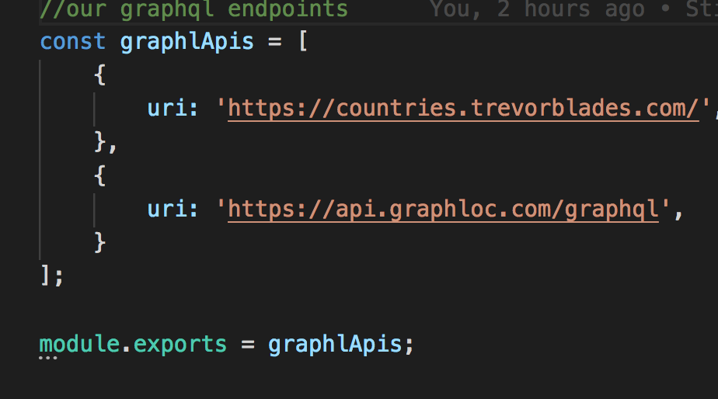
Steps to be followed
Step 1: Collect list of GraphQL sources

Slide 10
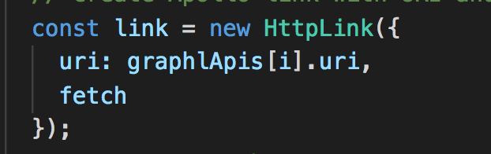

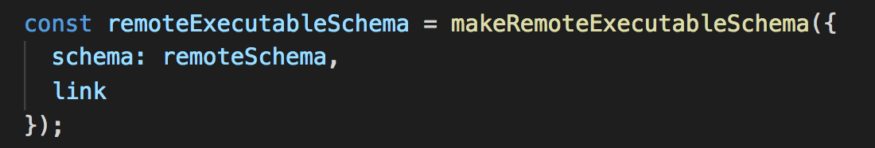
Steps to be followed
Step 2: Create Remote Executable Schemas
(i) Create HTTPLink from the endpoints
(ii) Introspect those Links and get the schema
(iii) Create Executable schemas using above two

Slide 11
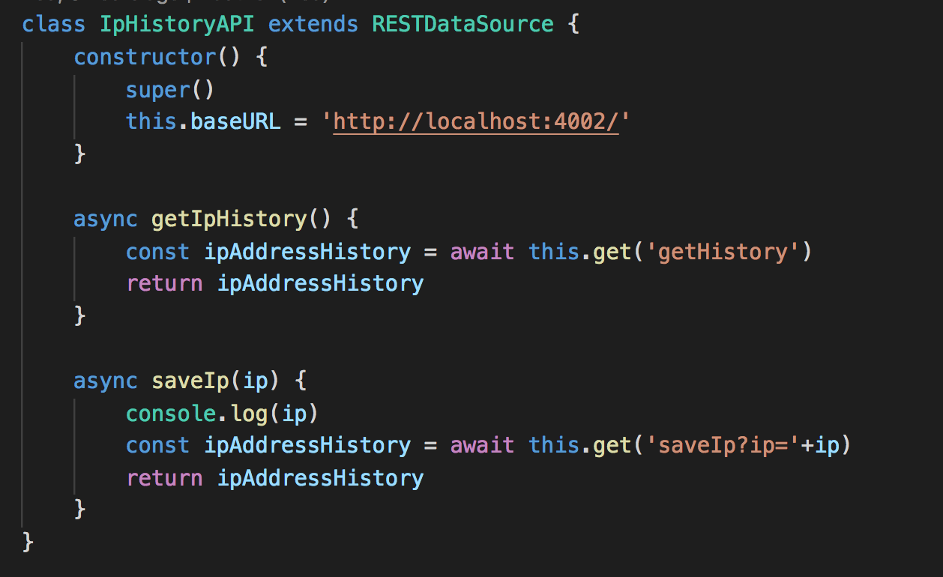
Steps to be followed
Step 3: Create DataSource for REST
(i) Create a dataSource Class with baseURL of the REST data Source
(ii) Create async methods for all REST endpoints

Slide 12
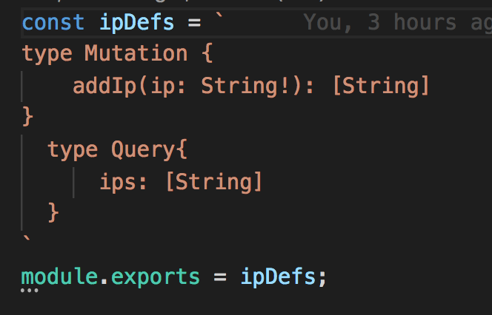
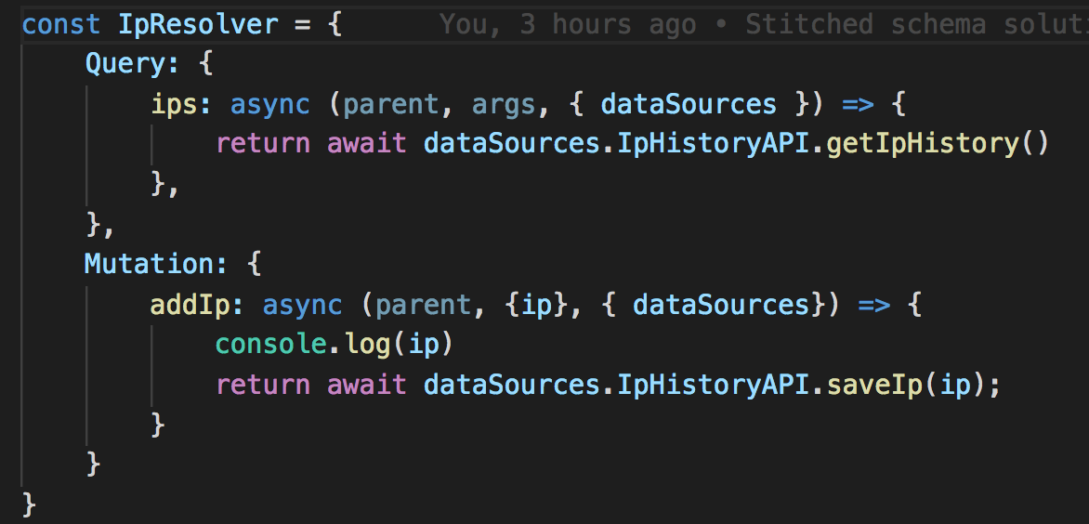
Step 4: Create TypeDef and Resolvers to convert REST to GraphQL schema
Steps to be followed

Slide 13
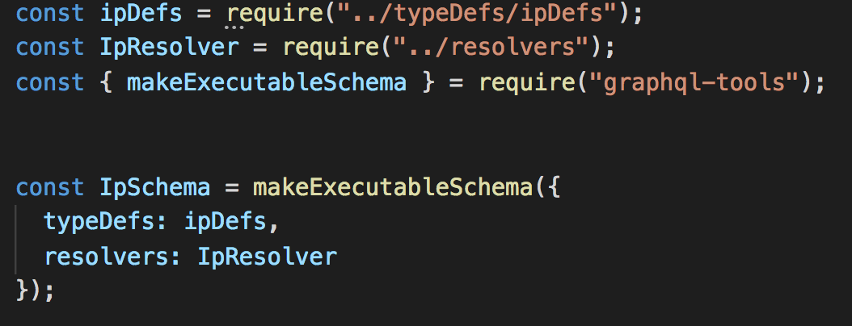
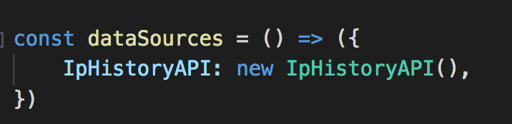
Steps to be followed
Step 5:
(i) Create Executable Schema for REST source
(II) Create instance of the DataSource to be used in the server

Slide 14

We have all the schemas ready, But wait...

Slide 15
In addition to merging schemas, linking and relating them gives more comfort.

Slide 16

“What Now?”

Slide 17
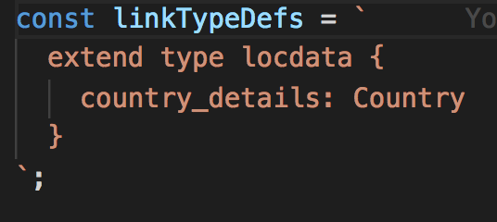
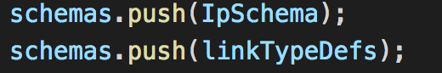
Steps to be followed
Step 6:
(i) Create Type Definition for demonstrating the link / relation between the 2 schemas
(ii) Merge all the three schemas and the Link-TypeDef into single array

Slide 18
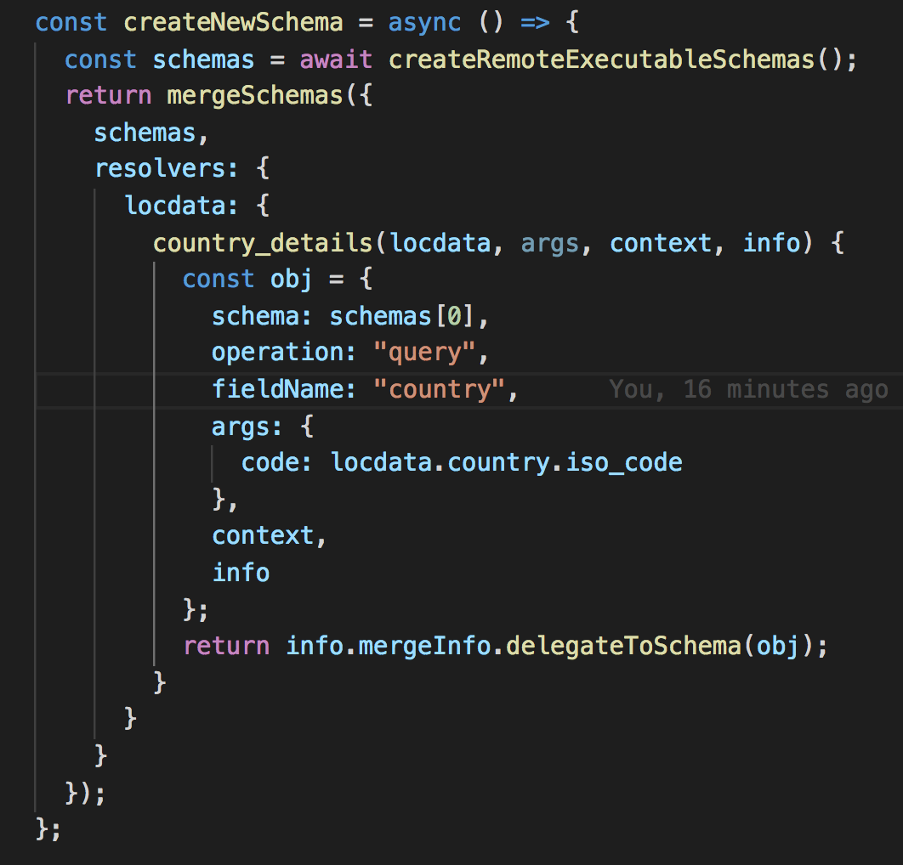
Steps to be followed
Step 7: With the schema array, Its time to merge them into single piece of S***.
Don’t forget to add the resolver for linking both the schemas

Slide 19
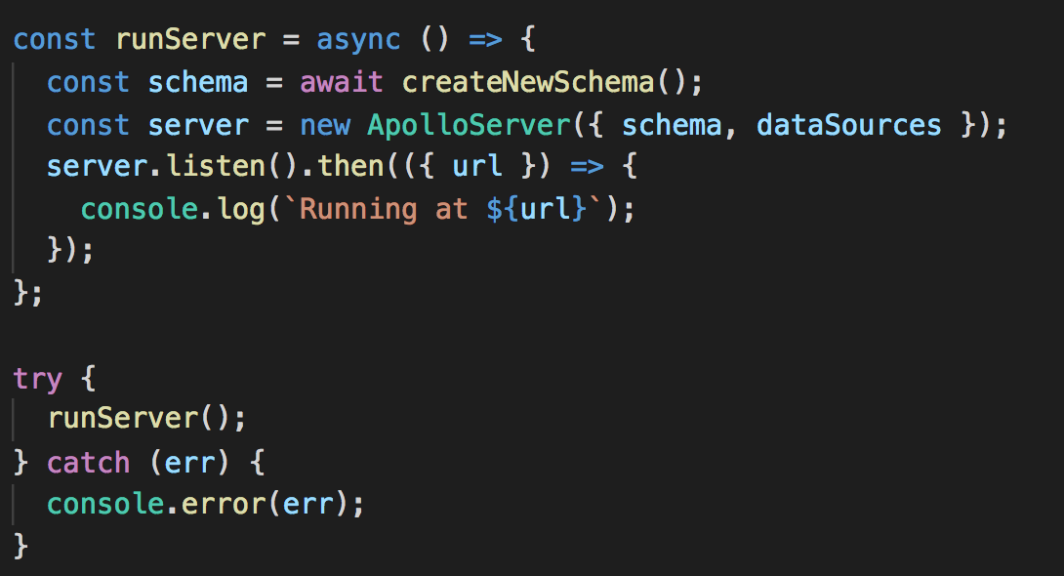
Steps to be followed
Last Step: Boot your Apollo Server and Boooommm… We have stitched the schemas together

Slide 20
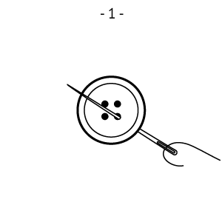
We did it - The Stitching

Slide 21

Further : Transform might Save you at times. Get Familiar

Slide 22




Thanks!
@vilvaathibanpb
Connect with me for a chat…
First Public talk, Hence Suggestions and feedbacks are expected earnestly.
Vilva Athiban P B
Vilva Athiban
Vilva Athiban P B
Vilva Athiban P B

